Slide 1

Learning Objective
I will I draw and describe boxplots and find the range and interquartile range of a data set
Enter quietly, please be ready with the following on your desk:
Whiteboard
Whiteboard marker
Exercise Book
Pencil, pen, ruler and red pen
Diary
Calculator
Device – charged or borrowed from Library before maths

Slide 2
Daily Review
To find the median of a data set:
Step 1: Order the numbers from smallest to largest. Step 2: Find the middle number.
Find the median, lower quartile and upper quartile of the following data set:
13, 15, 13, 11, 16, 13, 12, 15
11, 12, 13, 13, 13, 15, 15, 16
To find the lower quartile of a data set:
Step 1: Underline the bottom half of the data set. Step 2: Find the middle number.
To find the upper quartile of a data set:
Step 1: Underline the top half of the data set. Step 2: Find the middle number.
Median = 13
If the median is one of the values, don’t include it in the lower/upper half.
If the median is between two values, include it in the lower/upper half.
Lower quartile = 12.5
Upper quartile = 15

Slide 3
Daily Review
To find the median of a data set:
Step 1: Order the numbers from smallest to largest. Step 2: Find the middle number.
Find the median, lower quartile and upper quartile of the following data set:
435, 275, 195, 460, 565, 650, 335
195, 275, 335, 435, 460, 565, 650
To find the lower quartile of a data set:
Step 1: Underline the bottom half of the data set. Step 2: Find the middle number.
To find the upper quartile of a data set:
Step 1: Underline the top half of the data set. Step 2: Find the middle number.
Median = 435
If the median is one of the values, don’t include it in the lower/upper half.
If the median is between two values, include it in the lower/upper half.
Lower quartile = 275
Upper quartile = 565

Slide 4
Daily Review
To find the median of a data set:
Step 1: Order the numbers from smallest to largest. Step 2: Find the middle number.
Find the minimum, maximum, median, lower quartile and upper quartile of the following data set:
2, 9, 4, 2, 5, 8, 9, 6, 6, 2, 3, 7, 5
2, 2, 2, 3, 4, 5, 5, 6, 6, 7, 8, 9, 9
To find the lower quartile of a data set:
Step 1: Underline the bottom half of the data set. Step 2: Find the middle number.
To find the upper quartile of a data set:
Step 1: Underline the top half of the data set. Step 2: Find the middle number.
Minimum = 2
If the median is one of the values, don’t include it in the lower/upper half.
If the median is between two values, include it in the lower/upper half.
Maximum = 9
Median = 5
Lower quartile = 2.5
Upper quartile = 7.5

Slide 5
Learning Objective
CFU 1
What will we learn?
I will draw boxplots and find the range and interquartile range of a data set.
CFU 2
What will we learn?
CFU 3
How will we know if we’ve been successful?
Success Criteria
CFU 4
How will we know if we’ve been successful?
I will be able to:
Calculate the range by identifying the maximum and minimum in a data set.
Calculate the interquartile range by identifying the lower quartile and the upper quartile in a data set.

Slide 6
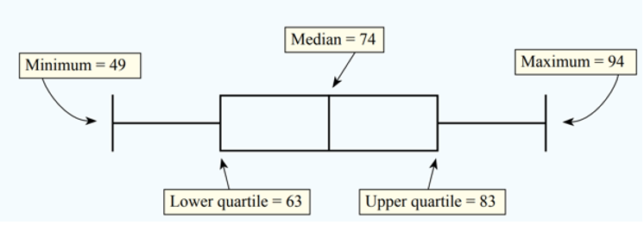
Concept Development
CFU 1
What information do we need to draw a box plot?
The box plot is a quick way of examining and comparing sets of data graphically.
The box plot is based on five pieces of information from a data set:
The minimum
The lower quartile
The median
The upper quartile
The maximum.
25%
25%
25%
25%
The bottom 25% of the data is in the section from the minimum to the lower quartile (Q1).
The middle 50% of the data is in the section from the lower quartile (Q1) to the upper quartile (Q3).
The top 25% of the data is in the section from the upper quartile (Q3) to the maximum.

Slide 7
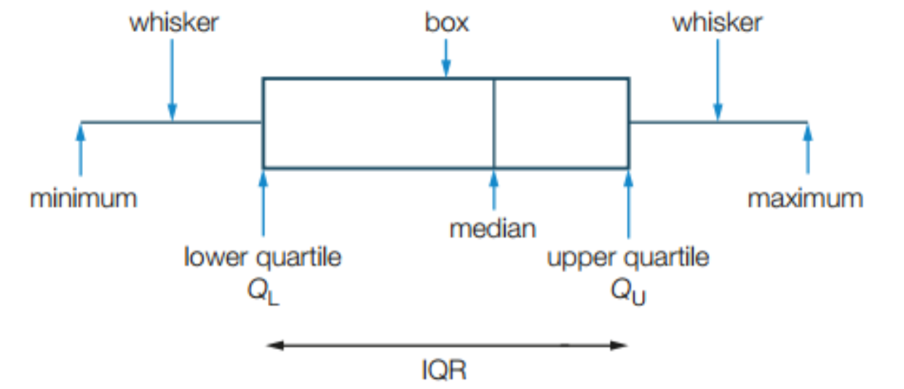
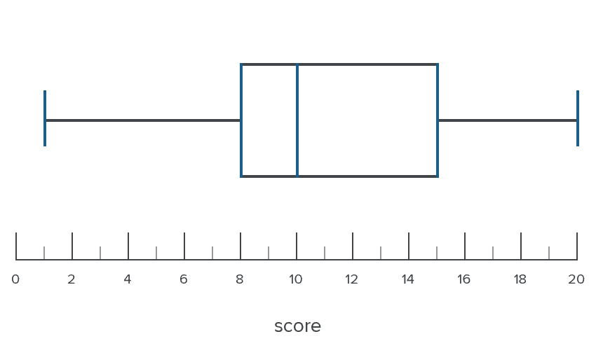
Skill Development
Find the 5 number summary, range and
inter-quartile range for this boxplot.
Minimum = 1
Lower quartile (Q1) = 8
Median = 10
Upper quartile (Q3) = 15
Maximum = 20
Range (maximum – minimum):
20 – 1 = 19
Inter-quartile range (Q3 – Q1):
15 – 8 = 7
25%
25%
What was the range in the first quartile of scores?
8 – 1 = 7
In which quartile were the scores least spread out?
The 2nd quartile

Slide 8
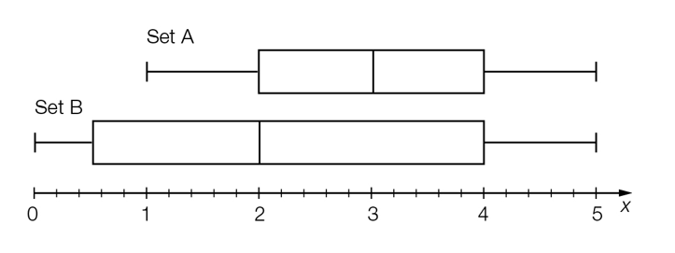
Guided Practice
Find the 5 number summary, range
and inter-quartile range for Set A.
Minimum = 1
Lower quartile (Q1) = 2
Median = 3
Upper quartile (Q3) = 4
Maximum = 5
Find the 5 number summary, range
and inter-quartile range for Set B.
Minimum = 0
Lower quartile (Q1) = 0.5
Median = 2
Upper quartile (Q3) = 4
Maximum = 5
Range (maximum – minimum):
5 – 1 = 4
5 – 0 = 5
Range (maximum – minimum):
Inter-quartile range (Q3 – Q1):
4 – 2 = 2
4 – 0.5 = 3.5
Inter-quartile range (Q3 – Q1):

Slide 9
Concept Development
To draw a box plot, you need a box and two whiskers.
The central part of the box plot, between the lower quartile and the upper quartile, is the ‘box.’ This box contains the middle 50% of the data values. We also draw a line through the box to show the value of the median.
The lines extending to the minimum and maximum values are the ‘whiskers’, which contain the remaining upper and lower 25% of the data values.

Slide 10
Skill Development
A Mathematics teacher creates a 5 number summary of their students’ test results.
Use this data to draw a boxplot.
Minimum | 10
Q1 | 35
Median | 55
Q3 | 70
Maximum | 100
Whisker
Box
Whisker

Slide 11
Guided Practice
A Science student records the temperature at midday every day for a month.
Draw a boxplot of their data.
Minimum | 13
Q1 | 15
Median | 16
Q3 | 18.5
Maximum | 24

Slide 12
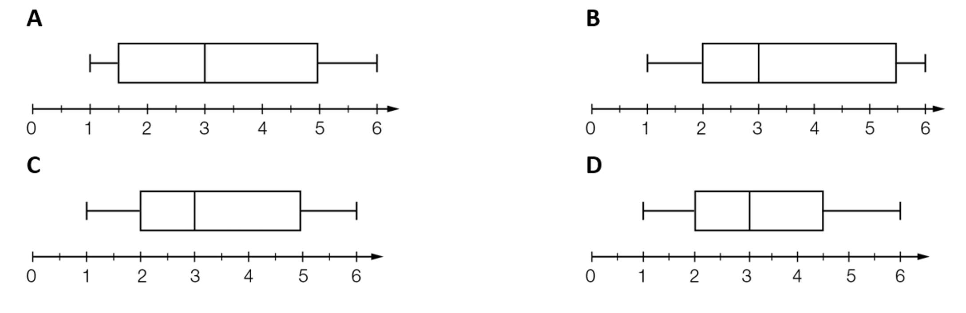
Skill Closure
Minimum | 1
Q1 | 2
Median | 3
Q3 | 5.5
Maximum | 6
Which boxplot represents the following data set?

Slide 13

Concept Development
CFU 1
What does range show?
The range shows how far the data is spread out.
Two Mathematics classes take the same test.
Class 1’s results (%) are: 21, 23, 24, 65, 67, 80 and 82.
Class 2’s results (%) are: 56, 58, 61, 65, 66, 70 and 72.
The median score for both classes is 65.
The range for class 1 is: 82 – 21 = 61.
The range for class 2 is: 72 – 56 = 16.
Although both classes had the same median, the data
for class 1 was more spread out than the data for class 2.
We know this because the range was bigger.

Slide 14


Concept Development
CFU 1
What does inter-quartile range show?
The inter-quartile range shows the spread of the data between the lower quartile and the upper quartile (the middle half of the data set). It’s sometimes more useful than the range because it doesn’t have any extreme low or high values in it.
Another Mathematics class takes the same test as before.
Class 3’s results (%) are: 2, 42, 54, 61, 65, 67, 72, 80, 99.
The range for class 3 is: 99 – 2 = 97.
The range for class 3 is high, but it does contain an extreme low (2) and an extreme high (99).
The inter-quartile range is: 76 – 48 = 28.
The inter-quartile range for class 3 is much smaller, showing that the middle half of the class got scores quite close to the median of 65.
Minimum = 2
Maximum = 99
Median = 65
Lower quartile = $\frac{42+54}{2}=48$
Upper quartile = $\frac{72+80}{2}=76$

Slide 15
Skill Development
To find the median of a data set:
Step 1: Order the numbers from smallest to largest. Step 2: Find the middle number.
By finding the 5 number summary of the data set, calculate the range and the inter-quartile range.
36, 52, 53, 55, 61, 66, 78
Minimum = 36
Lower quartile (Q1) = 52
Median = 55
Upper quartile (Q3) = 66
Maximum = 78
To find the lower quartile of a data set:
Step 1: Underline the bottom half of the data set. Step 2: Find the middle number.
To find the upper quartile of a data set:
Step 1: Underline the top half of the data set. Step 2: Find the middle number.
If the median is one of the values, don’t include it in the lower/upper half.
If the median is between two values, include it in the lower/upper half.
Range (maximum – minimum):
78 – 36 = 42
Inter-quartile range (Q3 – Q1):
66 – 52 = 14

Slide 16
Guided Practice
To find the median of a data set:
Step 1: Order the numbers from smallest to largest. Step 2: Find the middle number.
By finding the 5 number summary of the data set, calculate the range and the inter-quartile range.
21, 34, 53, 65, 66, 67, 92
Minimum = 21
Lower quartile (Q1) = 34
Median = 65
Upper quartile (Q3) = 67
Maximum = 92
To find the lower quartile of a data set:
Step 1: Underline the bottom half of the data set. Step 2: Find the middle number.
To find the upper quartile of a data set:
Step 1: Underline the top half of the data set. Step 2: Find the middle number.
If the median is one of the values, don’t include it in the lower/upper half.
If the median is between two values, include it in the lower/upper half.
Range (maximum – minimum):
92 – 21 = 71
Inter-quartile range (Q3 – Q1):
67 – 34 = 33

Slide 17
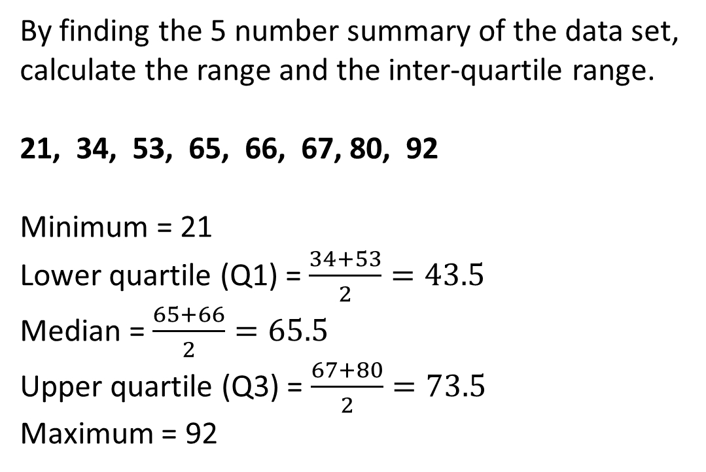
Guided Practice
To find the median of a data set:
Step 1: Order the numbers from smallest to largest. Step 2: Find the middle number.
By finding the 5 number summary of the data set, calculate the range and the inter-quartile range.
21, 34, 53, 65, 66, 67, 80, 92
Minimum = 21
Lower quartile (Q1) = $\frac{34+53}{2}=43.5$
Median = $\frac{65+66}{2}=65.5$
Upper quartile (Q3) = $\frac{67+80}{2}=73.5$
Maximum = 92
To find the lower quartile of a data set:
Step 1: Underline the bottom half of the data set. Step 2: Find the middle number.
To find the upper quartile of a data set:
Step 1: Underline the top half of the data set. Step 2: Find the middle number.
If the median is one of the values, don’t include it in the lower/upper half.
If the median is between two values, include it in the lower/upper half.
Range (maximum – minimum):
92 – 21 = 71
Inter-quartile range (Q3 – Q1):
73.5 – 43.5 = 30

Slide 18
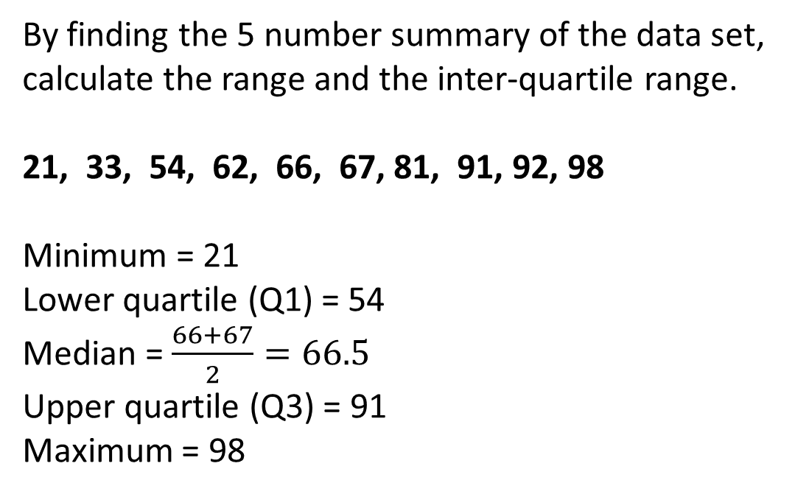
Guided Practice
To find the median of a data set:
Step 1: Order the numbers from smallest to largest. Step 2: Find the middle number.
By finding the 5 number summary of the data set, calculate the range and the inter-quartile range.
21, 33, 54, 62, 66, 67, 81, 91, 92, 98
Minimum = 21
Lower quartile (Q1) = 54
Median = $\frac{66+67}{2}=66.5$
Upper quartile (Q3) = 91
Maximum = 98
To find the lower quartile of a data set:
Step 1: Underline the bottom half of the data set. Step 2: Find the middle number.
To find the upper quartile of a data set:
Step 1: Underline the top half of the data set. Step 2: Find the middle number.
If the median is one of the values, don’t include it in the lower/upper half.
If the median is between two values, include it in the lower/upper half.
Range (maximum – minimum):
92 – 21 = 71
Inter-quartile range (Q3 – Q1):
73.5 – 43.5 = 30

Slide 19
Independent Practice
Mathspace – Year 10 Mainstream PPT Drawing Box Plots and Finding Interquartile Range CLASSWORK

